Slide 1
A Project On
Supply chain analysis
-By group-1
Shubham nema
Anjali nema
Sayali
Richa
Sanket
jenil

Slide 2
Introduction
*By analysing this data set ,we aim to understand performance of supply chain management ,identify trends and extract valuable insights to drive business growth and improve overall efficiency .
*The project will involve exploring different aspects inventory management such as top store ,daily sales of products, sales by region, profit margin, inventory value ,ytd,qtd,mtd,total customers performance and many more………
*Through this supply chain management analysis project ,we hope to cover valuable insights that can be contribute to better decision making operational effieciency and customer satisfaction .
*The finding and analysis could potentially guide marketing and inventory strategies ,sellers ,customers onboarding & other crucial aspects of the economic business.

Slide 3



tools used

Slide 4
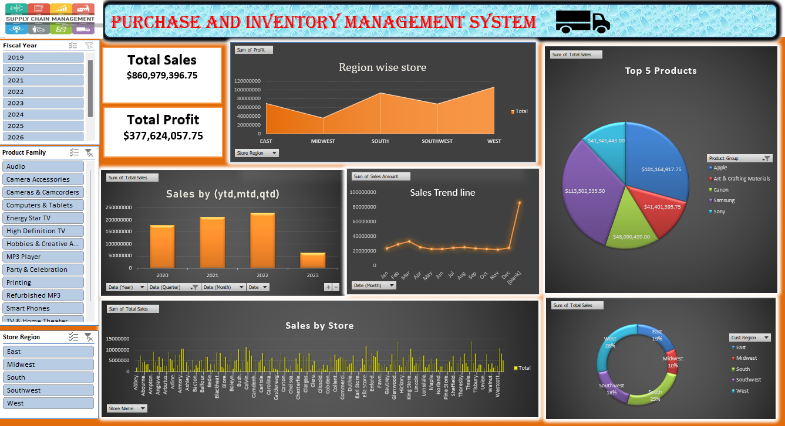
Excel Dashboard

Slide 5
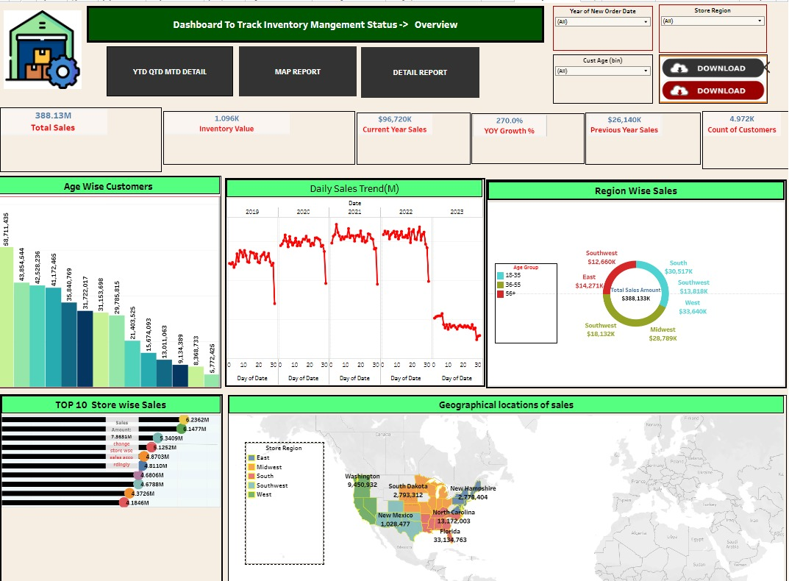
TABALEAU Dashboard

Slide 6
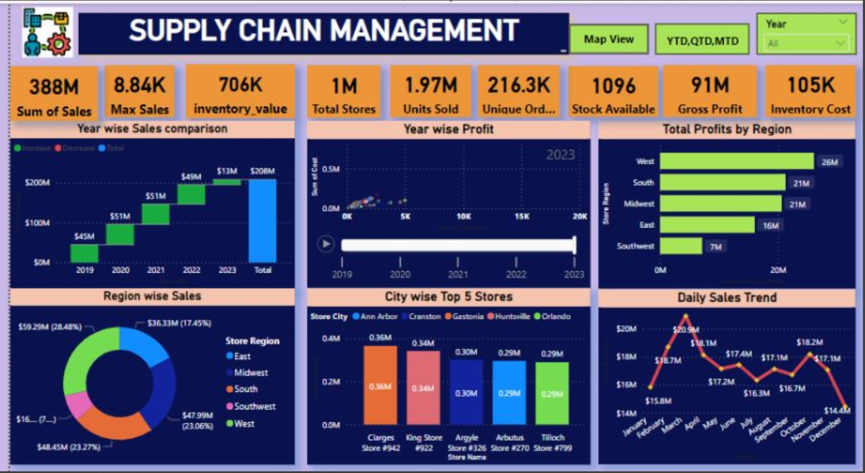
Power Bi Dashboard

Slide 7
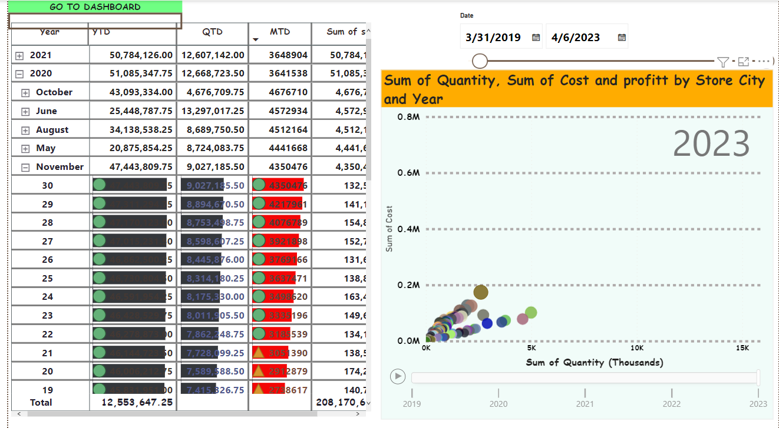
YTD Analysis

Slide 8
Summary
During this project on supply chain management Analysis We utilized Excel,for data modelling, manipulation and visualization.
We Empolyed dashboards in Tableau and Power bi to create a comprehensive view of key performance indicator(KPI’S).
The kpis we focused on daily sales trends,region wise sales,top n stores ,brand wise sales,Inventory value,profit margin,unique orders,total orders nd so on…
Overall regular monitoring of customer reviews,real time tracking of fleet performance,together with proper shipment tracking and communication system can improve suplly chain management delivery and performance and ensure are highly satisfied with the overall sales.

